Slide 1

SMART INDIA HACKATHON 2026
Dark Web Threat Actor Intelligence Platform
Problem Statement ID –SIH26151
Problem Statement Title-Dark web threat actor de-anonymization
Theme-Blockchain & Cybersecurity
PS Category- Software
Team ID-
Team Name- Kang Tanteyi

Slide 2
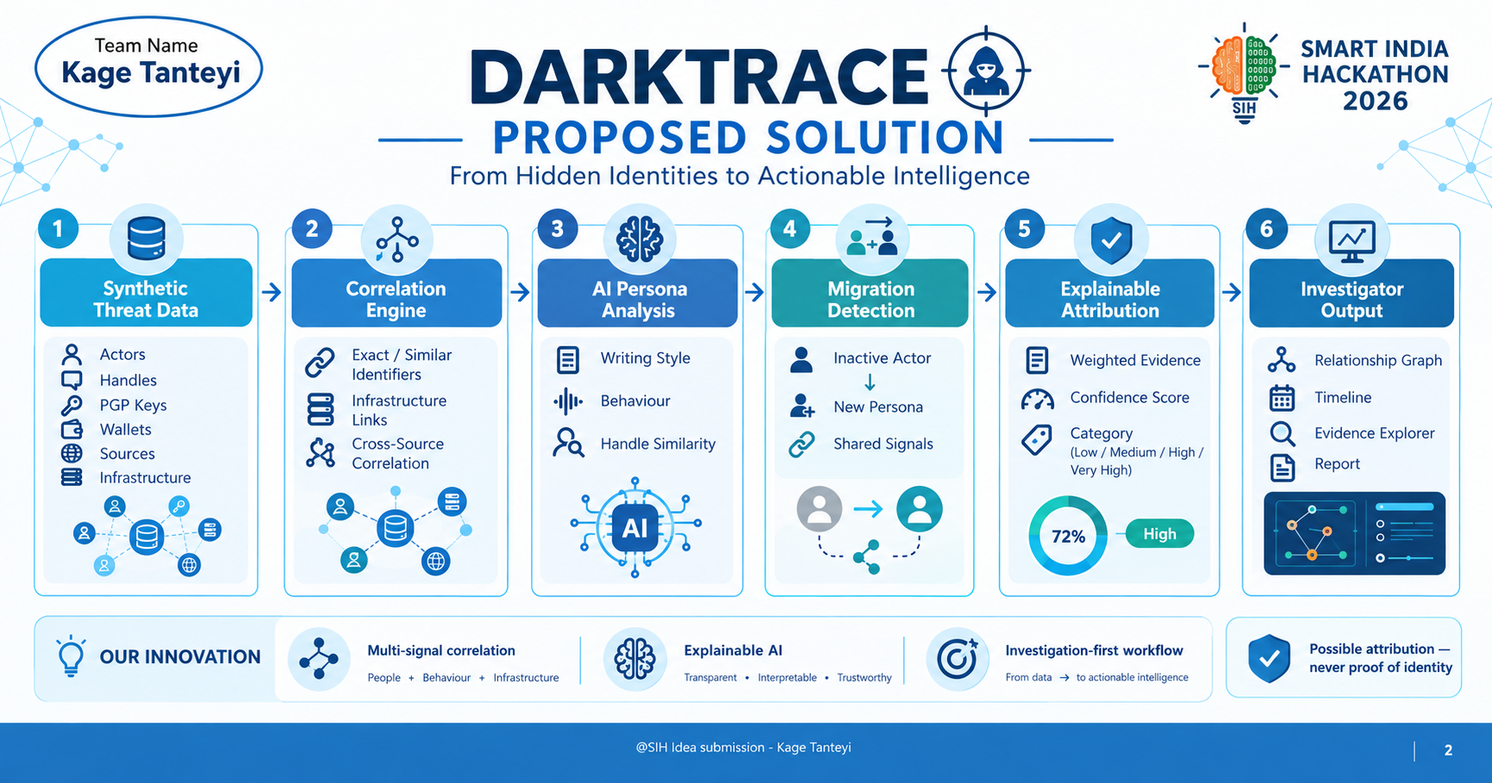
IDEA TITLE
Kage Tanteyi
Proposed Solution (Describe your Idea/Solution/Prototype)
Detailed explanation of the proposed solution
How it addresses the problem
Innovation and uniqueness of the solution

Slide 3
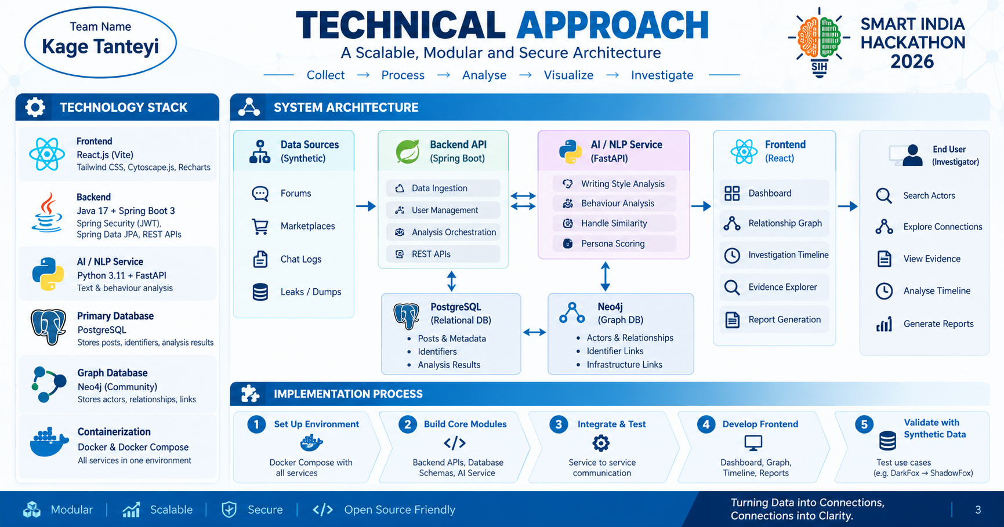
TECHNICAL APPROACH
Kage Tanteyi
Technologies to be used (e.g. programming languages, frameworks, hardware)
Methodology and process for implementation (Flow Charts/Images/ working prototype)

Slide 4
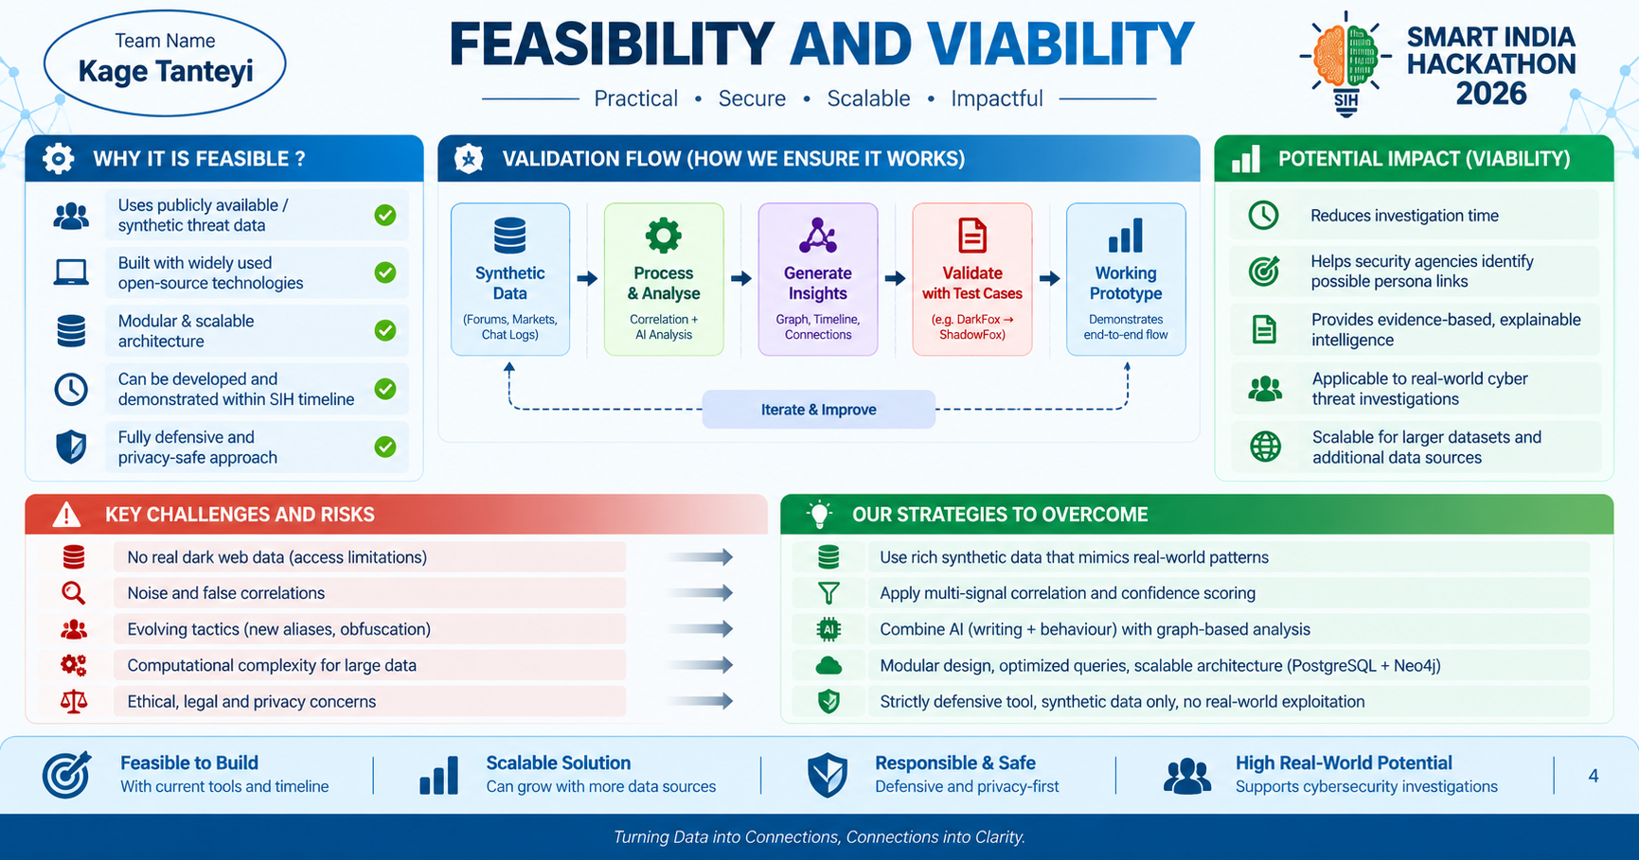
FEASIBILITY AND VIABILITY
Kage Tanteyi
Analysis of the feasibility of the idea
Potential challenges and risks
Strategies for overcoming these challenges

Slide 5

IMPACT AND BENEFITS
Kage Tanteyi
Potential impact on the target audience
Benefits of the solution (social, economic, environmental, etc.)

Slide 6
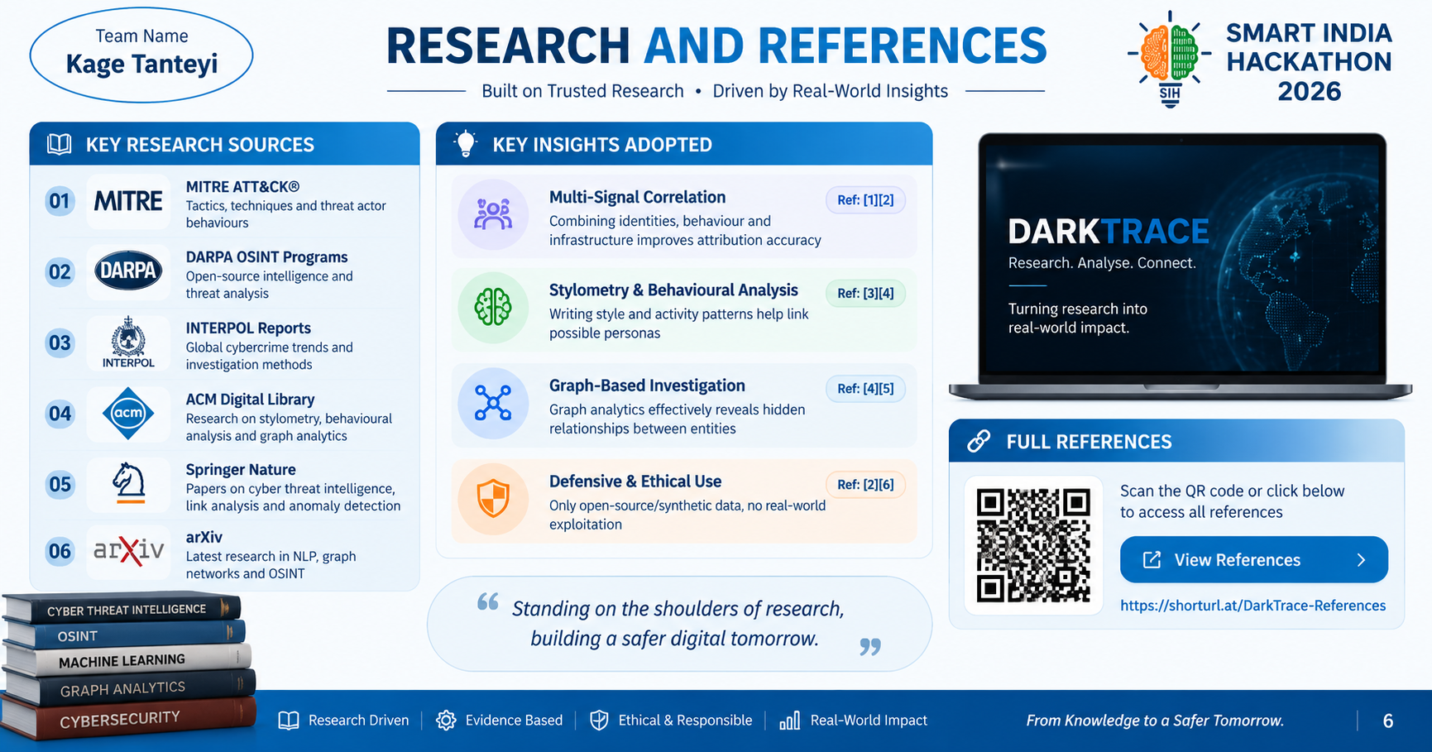
RESEARCH AND REFERENCES
Kage Tanteyi
Details / Links of the reference and research work

